Slide 1
air transport
File created on: 10/12/2023 4:03:35 PM

Slide 2
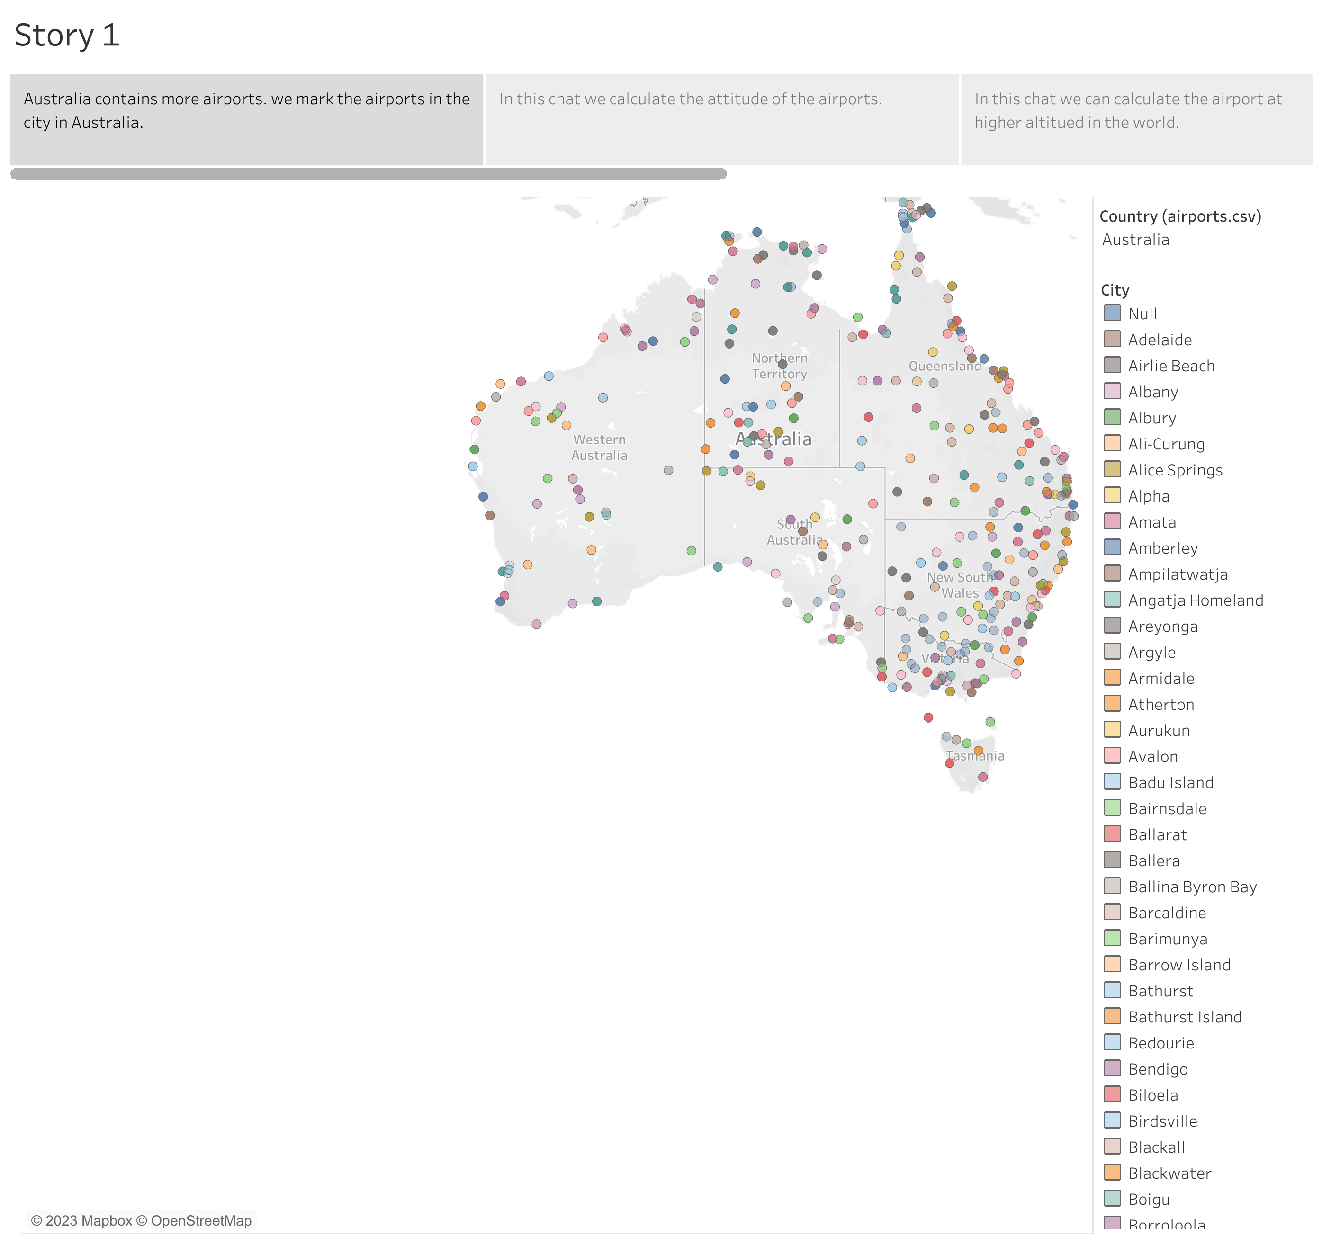

Slide 3
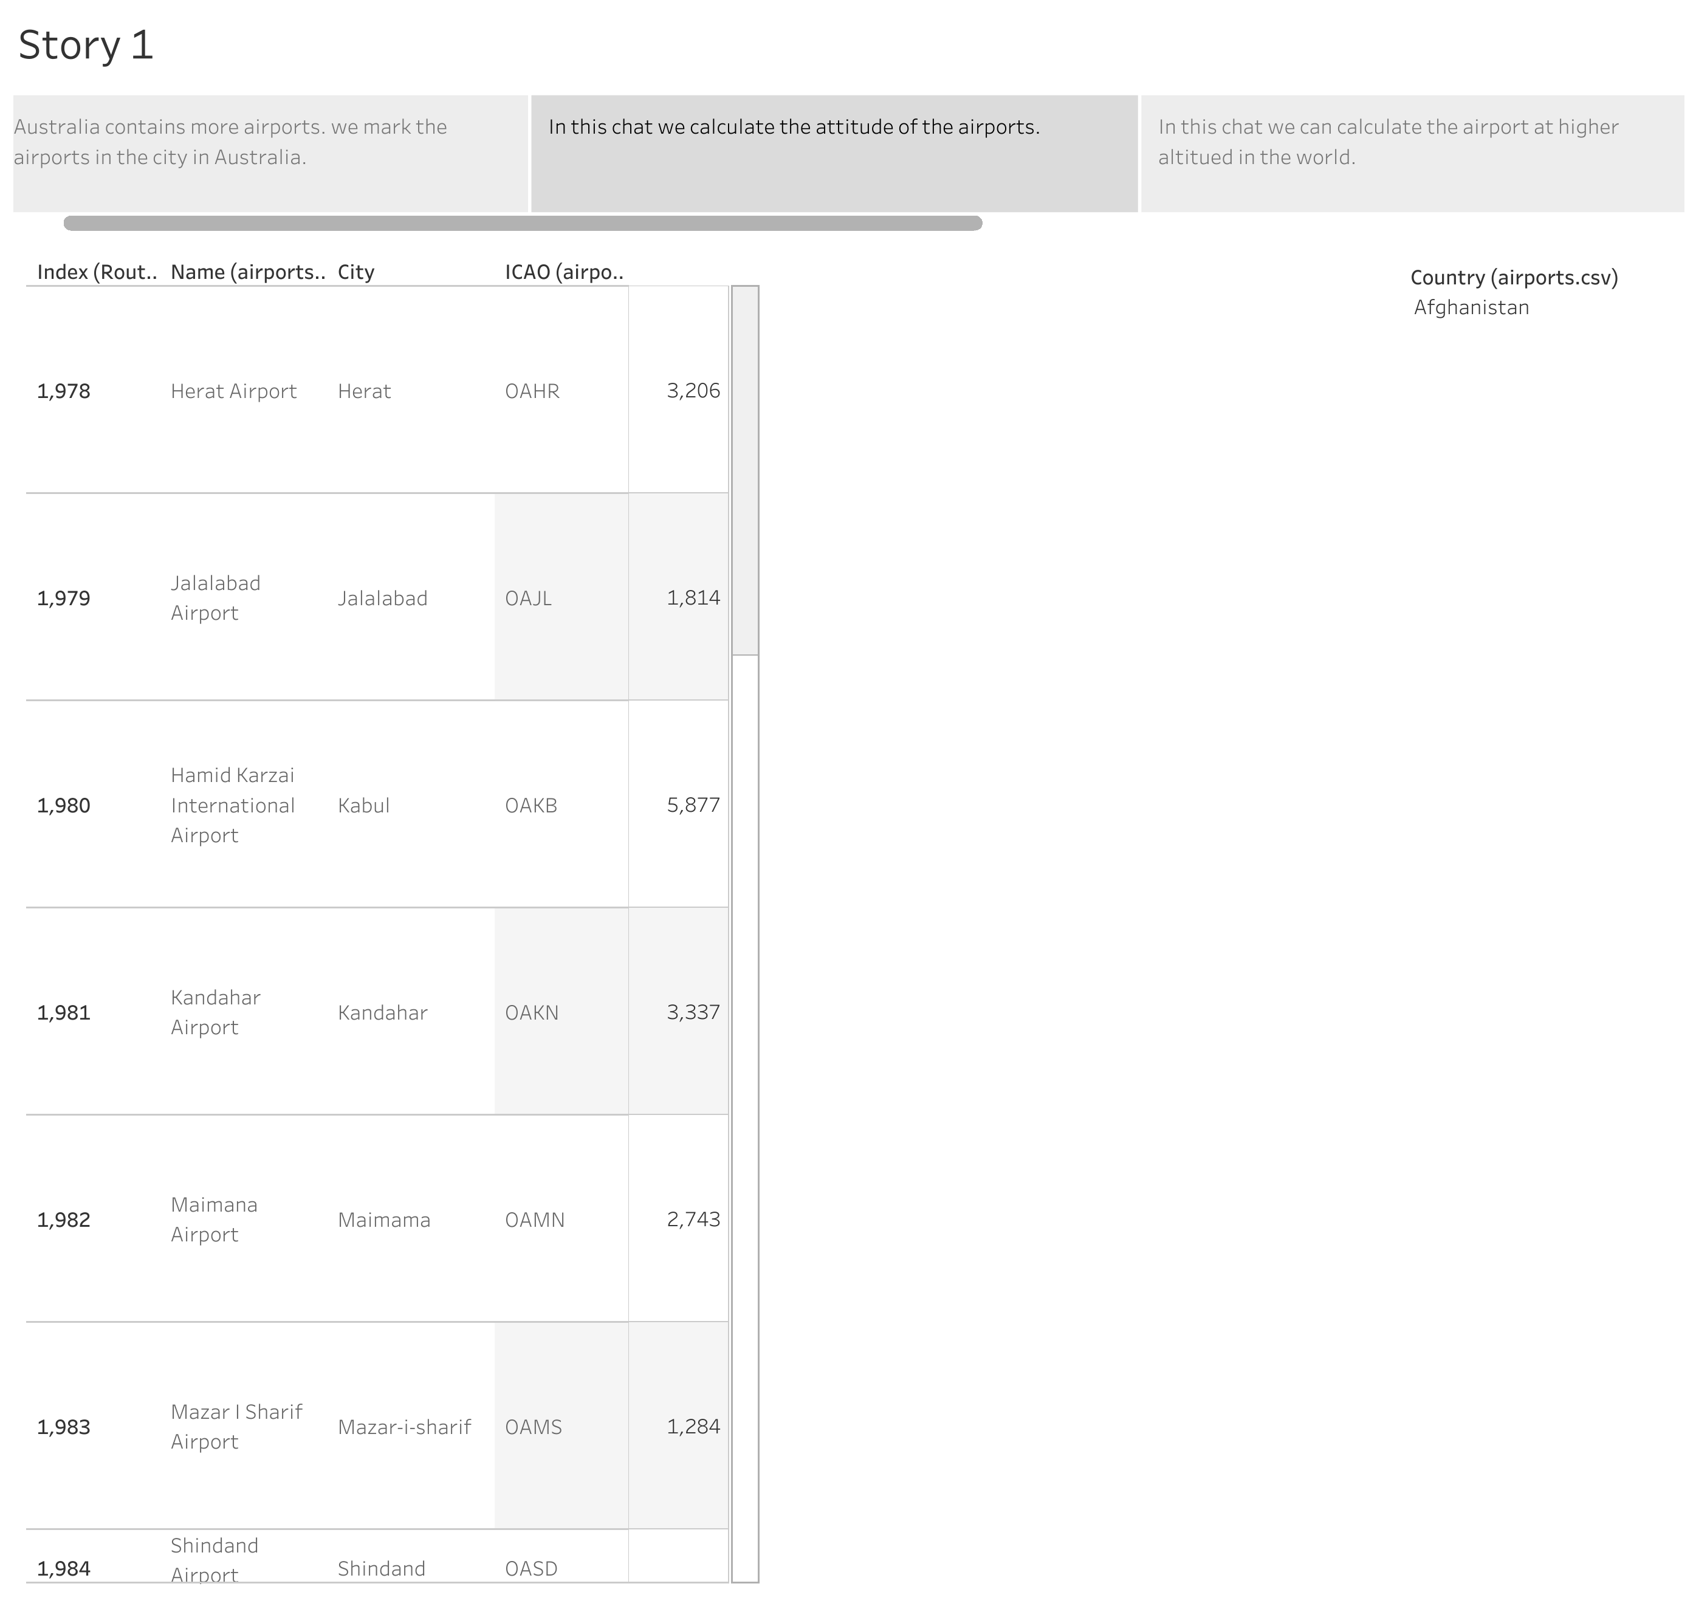

Slide 4
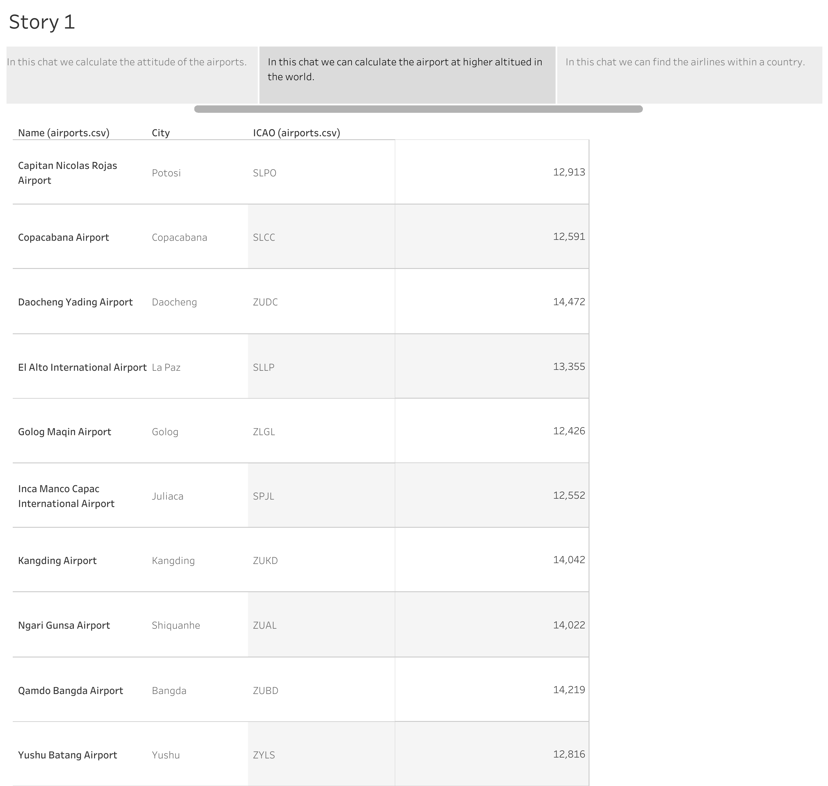

Slide 5
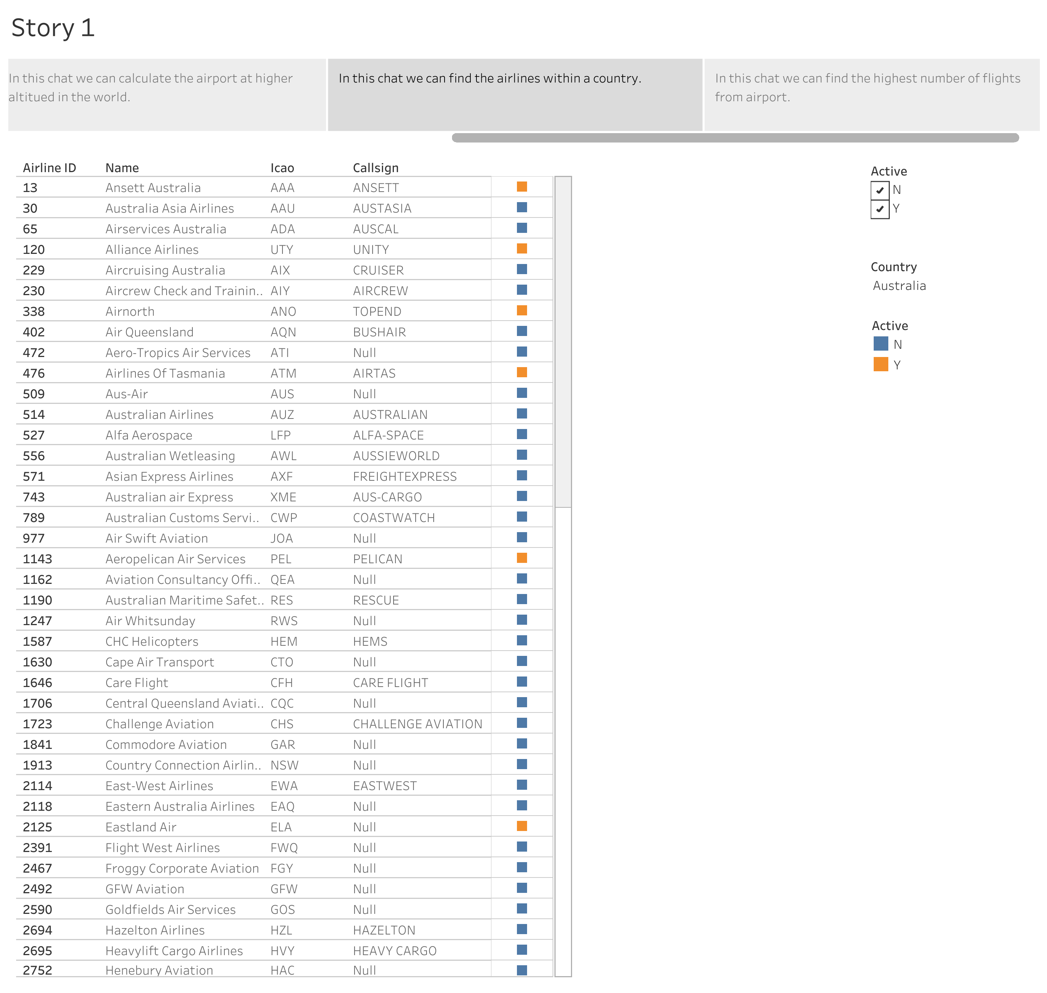

Slide 6
